Slide 1
0
 | 0 | 1 | 2 | 3 | 4 | 5
0 | 0 | 1 | 1 | 1 | 0 | 0
1 | 1 | 0 | 0 | 0 | 1 | 1
2 | 1 | 0 | 0 | 0 | 0 | 1
3 | 1 | 0 | 0 | 0 | 0 | 0
4 | 0 | 1 | 0 | 0 | 0 | 0
5 | 0 | 1 | 1 | 0 | 0 | 0
1
2
3
4
5
Graph
Undirected
Adjacency Matrix

Slide 2

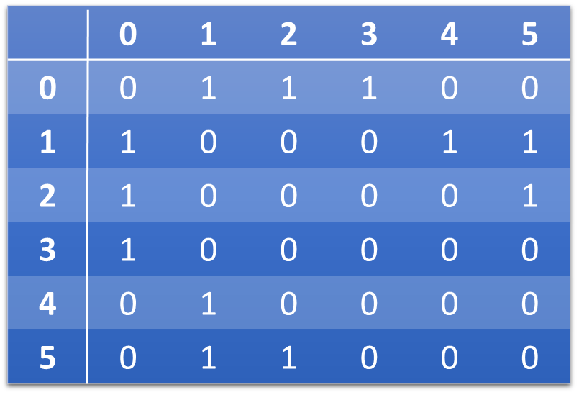
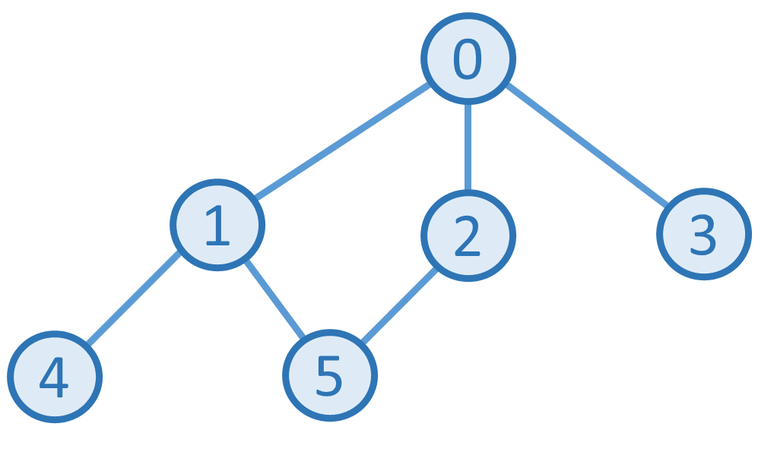
Stack
Step 1:
0
Popped:

Slide 3
Stack
Step 2:
0 | 1
Popped:

Slide 4
Stack
Step 3:
0 | 1 | 4
Popped:

Slide 5
Stack
Step 4:
0 | 1
Popped: 4

Slide 6
Stack
Step 5:
0 | 1 | 5
Popped: 4

Slide 7
Stack
Step 6:
0 | 1 | 5 | 2
Popped: 4

Slide 8
Stack
Step 7:
0 | 1 | 5
Popped: 4, 2

Slide 9
Stack
Step 8:
0 | 1
Popped: 4, 2, 5

Slide 10
Stack
Step 9:
0
Popped: 4, 2, 5, 1

Slide 11
Stack
Step 10:
0 | 3
Popped: 4, 2, 5, 1

Slide 12
Stack
Step 11:
0
Popped: 4, 2, 5, 1, 3

Slide 13
Stack
Step 12:
Popped: 4, 2, 5, 1, 3, 0

